Slide 1
Advance Materials for Future Technology
Dr. Nopporn Ruangsupapichat

Slide 2
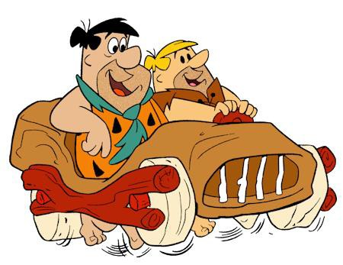
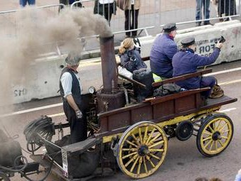
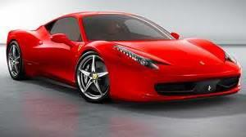


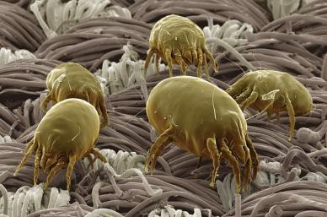
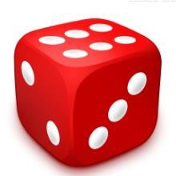
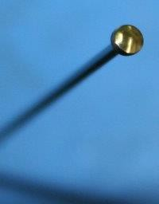
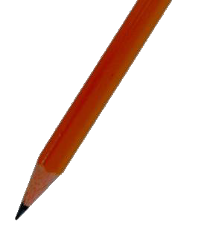
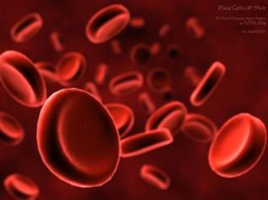
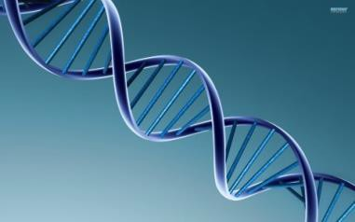
Technology
human (~2 m)
steam car
car (2.1 x 4.8 x 1.5 m³)
dice (~ 1 cm)
(10⁻² m)
dust mite (~ 300 μm) (10⁻⁴ m)
head of
a pin (~ 1 mm) (10⁻³ m)
pencil (~ 2 dm) (10⁻¹ m)
blood cell (~ 2 μm wide)
(10⁻⁶ m)
strand of DNA (~ 2 nm wide) (10⁻⁹ m)
Nanotechnology
Pictures are from Google images

Slide 3

Our future dream
In 1966, beyond our nanotechnology
Fantastic Voyage
http://www.youtube.com/watch?v=3o8vsU0Dw-4

Slide 4
Netherlands
Prof. Ben Feringa

Slide 5

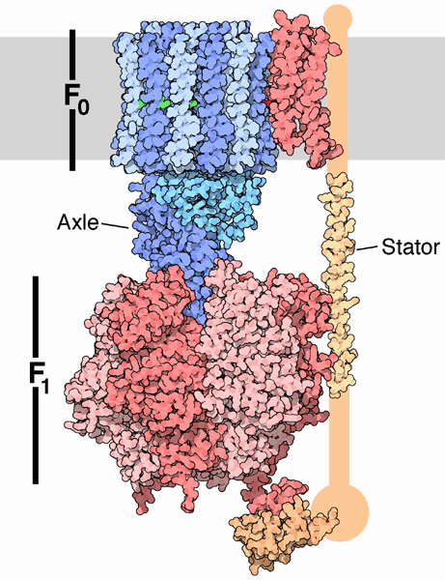
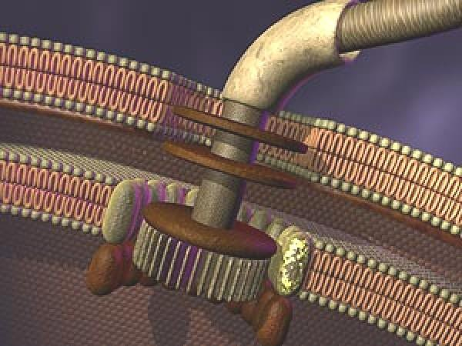
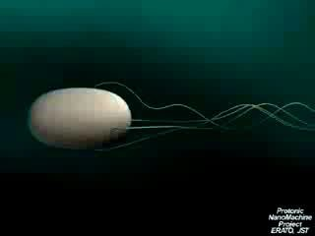
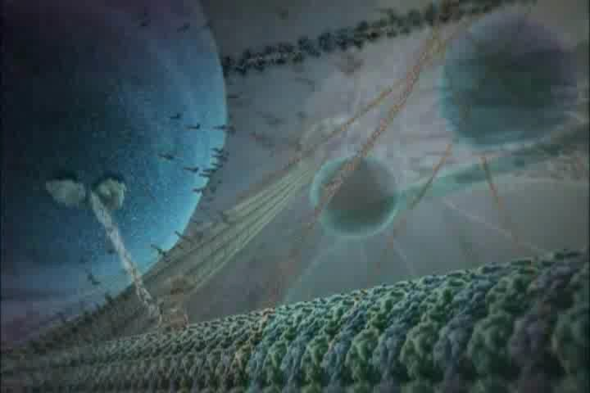
Biological molecular machines
_{H}+
_{H}+
_{H}+
Hydrogen ion
_{H}+
F F -ATPase
Membrane
1 0
Movements of biological machines
directional
fuelled
Axle
H
+
Stator
ADP and phosphate
ATP
ATP synthase
Flagellum bacteria
Kinetin (BioVisions at Harvard) University)
a) M. Schliwa, Molecular Motors ,Wiley-VCH, Weinheim, 2003. b) M. G. L. van den Heuvel, C. Dekker, Science
2007, 317, 333. c) Video of motor function of flagellum bacteria, H. C. Berg, Harvard University.

Slide 6
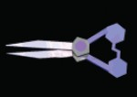
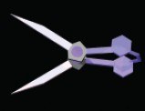
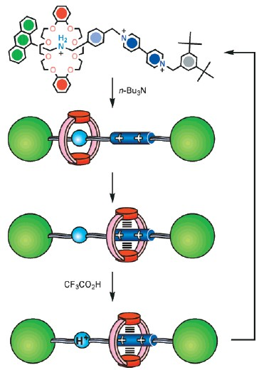
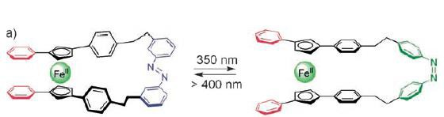
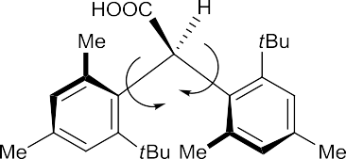

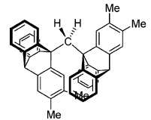
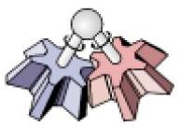

Artificial molecular machines
A)
Nanoshuttles
Nanotweezers
blade
_{pivot} trans-azobenzene
strap
UV
cis-azobenzene
Visible
A)
B)
(3.H)³⁺
n-Bu₃N
B)
trans-14
cis-14
ring shuttling
C)
Nanopropeller
₃2+
CF₃COOH
ring shuttling
D)
Nanogear
a) W. R. Browne, B. L. Feringa, Nat. Nanotechnol. 2006, 1, 25-35. b) V. Balzani, A. Credi, M. Venturi, ChemPhysChem
2008, 9, 202-220.

Slide 7
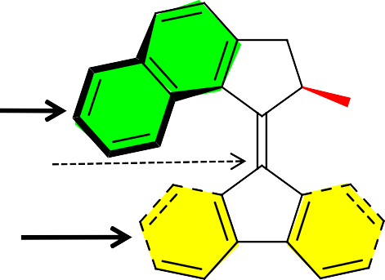
Nanomotors
Nanomotor is the machine in
which can convert external energy
nanoscale
into
mechanical motion or movement
rotor
axle
stator

Slide 8
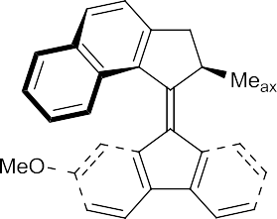
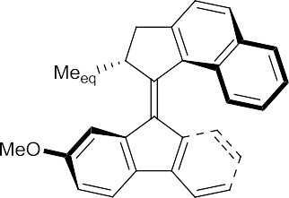
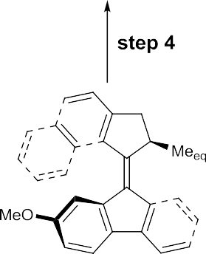
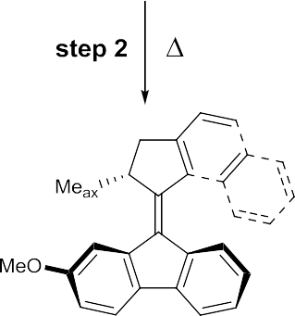

Requirements
Fuelling (Energy consumption)
Actively propelled motion
Control of directionality
Motor function (Continuous)
Fighting Brownian motion (on surface)
Artificial nanomotors
Me_{eq}
MeO
MeO
axle
Me_{ax}
Top view
Me_{ax}
MeO
MeO
Me_{eq}

Slide 9
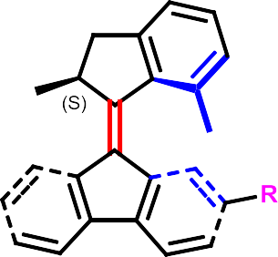
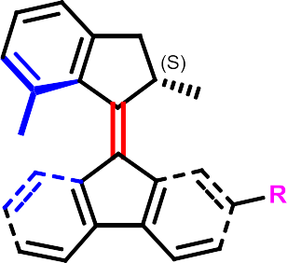
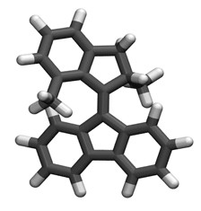
Light-driven molecular motor
isomerization
(light or electricity)
equatorial
unstable conformer
helix inversion
helix inversion
(spontaneous process)
axial
stable conformer
isomerization
a) N. Koumura, R. W. J. Zijlstra, R. A. van Delden, N. Harada, B. L. Feringa, Nature 1999, 401, 152-155. b) N. Koumura, E.
M. Geertsema, M. B. van Gelder, A. Meetsma, B. L. Feringa, J. Am. Chem. Soc. 2002, 124, 5037-5051. c) Modeling of a unidirectional molecular motor , J. C. M. Kistemaker

Slide 10
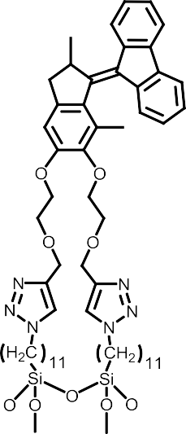
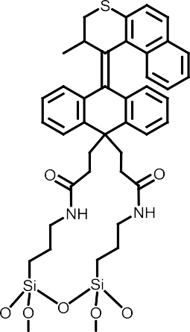
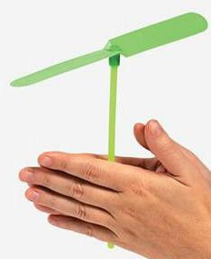
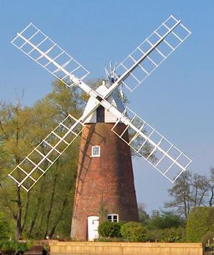
Advanced motors on surface
Azimuthal rotary motor
Nature 2006, 440, 163.
Altitudinal rotary motor
Chem. Commun. 2009, 1712.
Fighting Brownian motion (on a surface)

Slide 11
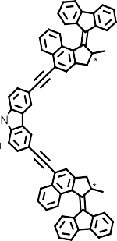
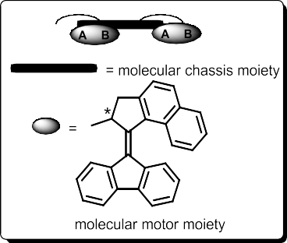
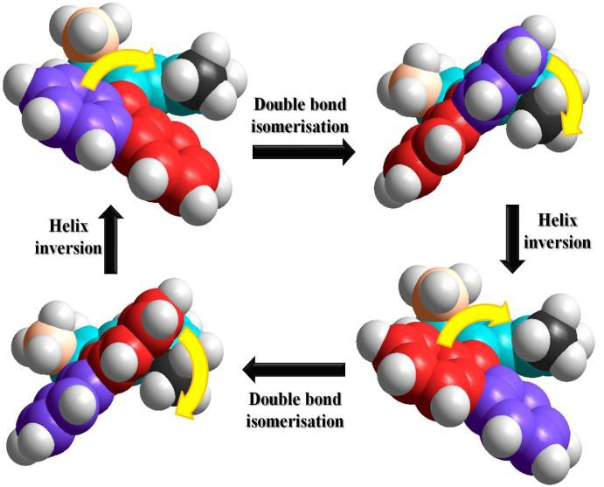
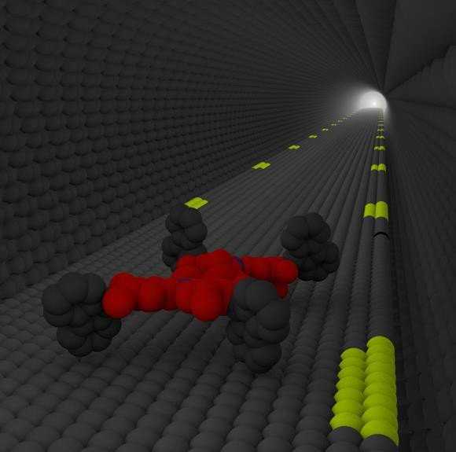
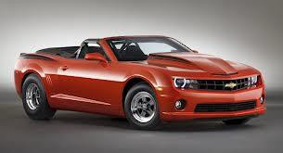




What else can we do?
Our dreams
To control directional motion on a surface using nanomotors as wheels
c
Car (2.1 x 4.8 x 1.5 m³)
Nanocar (1.5 x 2.3 x 0.8 nm³)

Slide 12
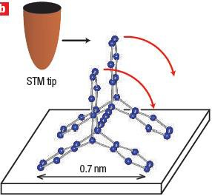
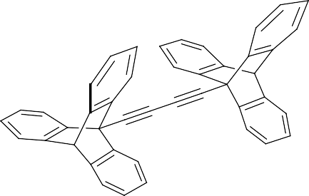
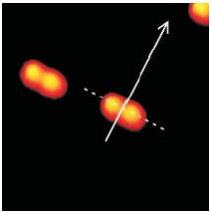
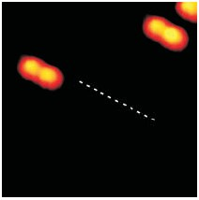
Few works already presented but!!
Translational movement by STM tip assisted (passive)
a
b
c
d
L. Grill, K.-H. Rieder, F. Moresco, G. Rapenner, S. Stojkovic, X. Bouju, C. Joachim, Nat. Nanotechnol. 2007, 2, 95-98.

Slide 13
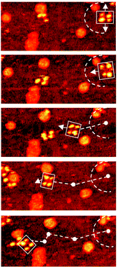
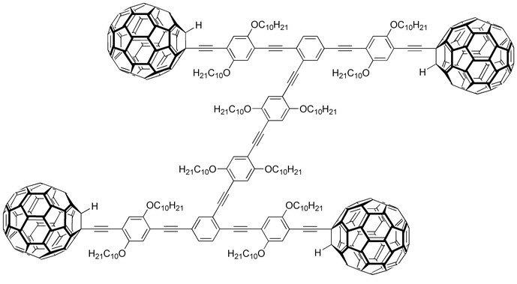
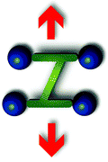
Translational movement by temperature powered (passive)
No motor function
Confined diffusion (no fuel)
Forward – backward motion
a) Y. Shirai, A. J. Osgood, Y. Zhao, K. F. Kelly, J. M. Tour, Nano Lett. 2005, 5, 2330-2334. b) Y. Shirai, J.-F. Morin,
T. Sasaki, J. M. Guerrero, J. M. Tour, Chem. Soc. Rev., 2006, 35, 1043-1055.

Slide 14
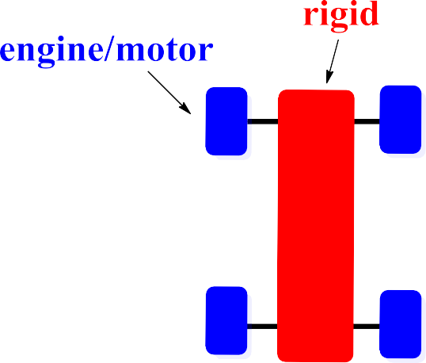

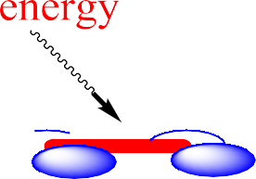




Molecular design
Artificial nanomachine capable of continuous mechanical work
upon fuelling on a surface (active)
Top view
Side view
four-wheeled molecule

Slide 15
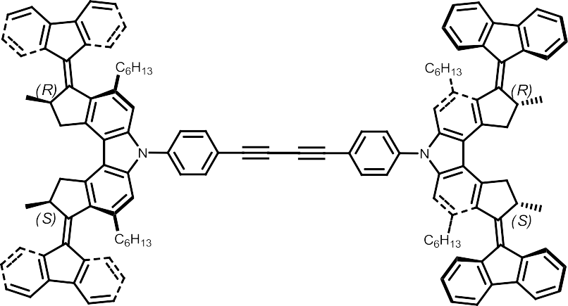
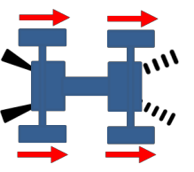
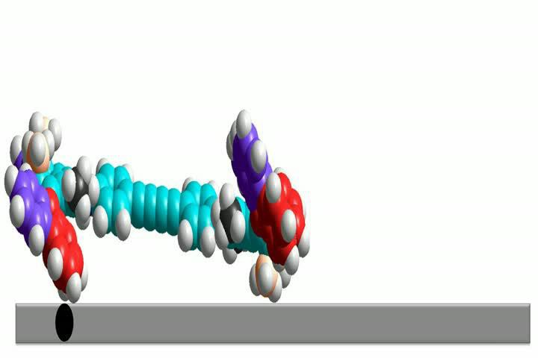
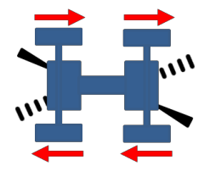




Directional of movements
meso-(R,S-R,S)-isomer
directed motion
(R,R-R,R)-isomer
random motion
(S,S-S,S)-isomer
Paddlewheel-like directed motion

Slide 16


How do we observe
Scanning Tunneling Microscope (STM) measurement
Basic components of STM
Gerd Binnig and Heinrich Rohrer at IBM in Zurich created the ideas of STM (Phys. Rev. Lett. 1982, 49, 57) and they won 1986 Nobel prize in physics for their brilliant invention.

Slide 17










On copper surface (UHV-STM, -266ºC)
Three-lobes structure
Four-lobes
structure
Three-lobes
structure
Four-lobes structure
4 motors, 2 helicities: 2⁴ = 16 conformers
Performed by Asst. Prof. Tibor Kudernac, at University Zurich

Slide 18









STM appearances (stable conformer)
Meso-isomer
(correct landing)
Meso-isomer
(wrong landing)
(R,R-R,R)-isomer
Side view
Top view
Related STM
images
Single isomer; 4 motors, 2 helicities: 2⁴ = 16 conformers

Slide 19



Propelled translational motion of a single molecule
racemate isomers
• Cu(111) at -266ºC
Excitation (via inelastic tunneling)
random motion
movement (random)
contrast change
(conformational changes)

Slide 20



Directional translational motion (symmetry breaking!!!)
meso-isomer (“correct landing”)
meso-isomer (“wrong landing”)
no movement observed!

Slide 21



Linearity of movements
meso-isomer
(R,R-R,R)-isomer
3
3
3
2
1
2
1
4
4
2
Preferentially linear 180°
120°
Random
0°
Random
theory experiment

Slide 22


Conclusion and Outlook
First active single molecule with propelled motions (from motors) on a surface has been demonstrated
Control of directionality of the motion: linear vs. random depends on the chirality
of molecular motors
T. Kudernac, N. Ruangsupapichat, M. Parschau, B. Maciá, N. Katsonis, S. R. Harutyunyan, K.-H. Ernst, B. L. Feringa,
Nature 2011, 418, 208-211.

Slide 23















Your future???
Nanomotorcycle
Nanotuktuk
First active nanocar, 2011
Nanotruck
Nanoboat
Fantastic Voyage: Movie 1966 (Far future???)

Slide 24

Acknowledgements
Stratingh Institute for Chemistry
(University of Groningen)
Prof. Ben L. Feringa
Asst. Prof. Syuzanna Harutyunyan Asst. Prof. Nathalie Katsonis Asst. Prof. Tibor Kudernac
Asst. Prof. Beatriz Maciá
Empa (Swiss Federal Laboratories for Materials Science and Technology)
Prof. Karl-Heinz Ernst Dr. Manfred Parschau

